Slide 1
Retail Business Intelligence Solution v7 Master Presentation
DTG
DTG
Notes:
Chart 1: Title Slide
Hello and welcome to this presentation where we will take a close look at how you can build a strong platform for leveraging your information assets and at how IBM business intelligence solutions can help. My name is XXXX and I am the xxxxxxx.
Author: Daniel Graham/Somers/IBM March 2004

Slide 2
Agenda
Key Retail Business Issues Addressed by BI
The Retail Enterprise Data Warehouse
Sample Scenario
Advanced Analytics
RBST’s in Detail

Slide 3
Retail Industry Trends Addressed By Business Intelligence

Slide 4




Retail leaders will enhance traditional intuitive approaches with Advanced Analytics
Increased Performance via Systematic Intelligence
Customer, operational, and competitive data
Real-time analytics, decision support, and predictive intelligence…
Business insights
Optimized operations
Market research
RFID
Merchandising
Assortment planning
Pricing and promotions
ERP
POS
1100 10 01 10010
1100 10 01 10010 11 1 1
111010 0 0 1 0 01101
Enterprise
Data Management
Customers
Stores
Store design and presentation
Employee management
Store Ops
In-store monitoring
Vendor data
…augmenting traditional creative/intuitive methods
Supply Chain
Demand forecasting
Inventory management
Warehouse management
Supply chain
Supply Chain
Source: IBM Institute for Business Value
Notes:
Many retailers caught in the gunsights of Wal-Mart, Tesco, and similar mega-retailers are, unsurprisingly, focused on reducing costs in order to afford lowering prices and stay “in the game”. But we would caution companies to heed the lessons of Kmart – where trying to compete on price led to a downward spiral of poor service, decreased customer satisfaction, and further losses.
Instead, retailers need to “play smarter”, not just “harder” with a sole focus on costs. And so the point we made about customer insights in the previous imperative applies equally well to core retail operations – not just customer management but also merchandising, store operations, and supply chain management. The successful retailers of the future will have highly flexible operations driven by what we call “systematic intelligence”.
Retailers have a wealth of data at their disposal – employee and enterprise data through ERP; supply chain data, such as orders, inventories, and forecasts; supplier data including account-specific services (such as category management); competitive information through more structured and formal information gathering and third-party information providers; and soon the explosion of RFID data, whether in the supply chain or in the store.
[click mouse to animate]
The challenge is to augment traditional, intuitive approaches to decision-making with the advanced analytical tools that are increasingly available.
Automated, real-time analytics
Data-driven decision support tools
Predictive modeling (e.g., for requirements forecasting, capacity allocation, or resource assessment)
[click mouse to animate]
…And thus to generate new insights about customers, operations and supply chain conditions…
[click mouse to animate]
..and ultimately to reach a higher level of operating excellence.
For instance, how can you boost profitability another 20-30% by having the capability to optimize prices or markdowns at the store-level on a weekly or even daily basis? Are you giving up too much margin, or not maximizing demand? How can you figure this out, and how can you act upon it quickly?

Slide 5
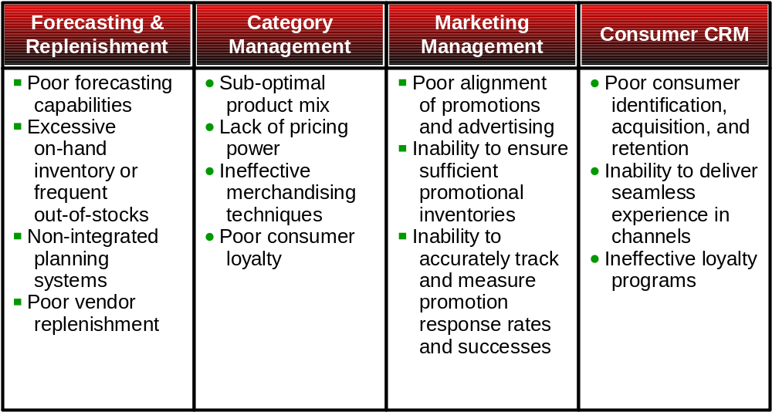
Business Intelligence is Critical to Achieving These Goals
BI addresses pain points in the following processes:

Slide 6

It’s all about the Customer…
Acquire, retain, & extend customer’s lifetime value
  Get the right customers
  Retain the profitable ones
  Migrate low profit clients to low cost channels
Solution areas
  Customer segmentation
  Customer acquisition
  Retention & Loyalty programs
  Winback Programs
  Campaign management
  Market basket analysis
  Profitability analysis
DTG
Notes:
Customer analytics give your company a better understanding of consumer needs and how they vary. First, we have to start with the customer’s life events and current attributes. Who are they, what do they want to buy, are they a prospect now or later? What is their lifetime value and how do we ensure that the interactions with the client are profitable? Some clients are unprofitable early in life –for example university students – but later are the best customers –now that the university educated person is a professional with 3 children and a home. So lifetime value is one measure we want for each type of customer.
Dozens of customer relationship experts have declared that acquiring a customer costs 5 times more than keeping one. Prospecting to new “white space” clients is expensive and solicitation response rates are usually poor. Consequently, developing a plan based on customer segmentation profiles, similar prospects, and personalized offers is the only way to ensure your prospecting money is well spent.
Existing customers tend to produce the bulk of revenues and profits which means that customer loyalty is a competitive necessity. So losing current customers –churn or lapses-- can be devastating to the financial bottom line. Most companies have the data to detect and predict which consumers will “attrite” and go to the competition. Some customer segments are high risk whereas certain interactions with the customer are telltale signs they will abandon you and go elsewhere. However, your first decision should be to determine if the client is profitable before spending marketing or sales energy on retaining them as a customer.
All of these activities have been proven to be effective using IBM’s DB2 data mining and data warehouse technologies. Gathering past transactions and even externally purchased data is the best way to get a clear understanding of customer segments, propensities to purchase, buying patterns, and cross sell opportunities. Generally, we like to treat the customers as if they were a portfolio, like a mutual fund or bond fund. We need to know when to invest, when to divest for the maximum value to the enterprise. Using the DB2 relational database and statistics, IBM software can compute a prospects life time value, the next most likely purchase, even the month or quarter that purchase is most likely. Knowing this, you can optimize your marketing and sales investments to mutual benefit with your clients. IBM DB2 deployments (State Farm) have shown the ability to improve the leads to closure rate from 24-to-1 down to 7-to-1, that is 7 cold calls to yield one closed deal. Similarly, we can dramatically cut the investment in direct and indirect campaigns while increasing the success per campaign from a mere 3% response rate to 8-11% response rate (Credit Union of Texas).
D.Graham

Slide 7
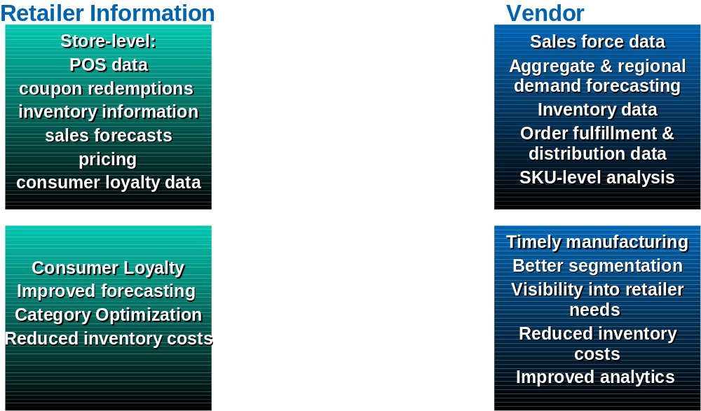
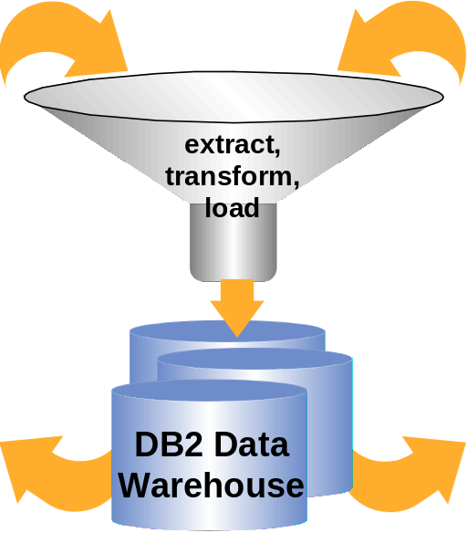
…and Collaborative Commerce

Slide 8
Why You Need an Enterprise Data Warehouse
Bernard Liautaud – CEO of Business Objects in Business Week Online 8-31-05
  “…. because CRM really automates your sales force. Business intelligence is at a different level. For instance, you want to know what your most profitable products are. Where are the data to help with that analysis? Well some of it is in the CRM, some is in the manufacturing system, and some is in the finance system. So you need to have a solution that cuts across all the different types of systems.
  … on average companies have between five and seven different types of databases and between 100 and 300 different types of applications. By definition, the infrastructure of companies is extremely heterogeneous. Even a company that says "I am an SAP shop" has hundreds of applications that are not covered by SAP, and when they do the analysis of their business, they need to have them in the fold. “
Forrester Report 8-9-05 Retail Gets Ready for In-Store Analytics
  In the past, a lack of accessible above-store information, either because of constrained bandwidth or decentralized store applications, hindered real-time alerts and analytics for store users. But while centralized deployments of in-store applications have come in and out of favor in the past, the pressure is on to increase them, as applications for both store employees and customers increasingly rely on information that is not held locally at the store. For in-store analytics and alerting, it means an opportunity to provide stores with information that they haven’t had regular access to before, such as how a store compares to its peers. Retailers should be cautiously optimistic about the opportunity — balancing a desire to provide stores with better tools with the temptation to provide too much information.

Slide 9
Retail Enterprise Data Warehouse

Slide 10

The IBM Retail Business Intelligence Solution:
Provides a consistent view of information across the enterprise.
Delivers advanced analytics and insight into core Retail process areas:
  Customer Management, Product & Service Management, Store Operations, Merchandising, Multi-Channel Management, Finance, HR, & Supply Chain.
Enables rapid, phased deployment
Offers a packaged, customizable, open environment
Leverages a retailer’s existing investment in people, process and technology
Combines IBM’s leading edge research, services, systems and software with deep industry knowledge.

Slide 11
The IBM Retail Business Intelligence Solution includes:
Retail Business Intelligence Reference Architecture and ARTS Compliant Enterprise Data Warehouse Model
Retail Optimized Business Intelligence Infrastructure (server, storage and software)
Retail specific templates for quick start analytics and reporting for Store Operations, Merchandising, Customer Management, Product Management and Multi-Channel
Retail Design and Implementation Services to help retailers prioritize their high business impact areas and allow for an easy deployment

Slide 12


Reporting without an Enterprise Data Warehouse
Operational
Sources
Corporate
Finance
Inconsistent
Reporting
Incorrect
Reporting
Sales
Purchsg
Customer
Management
Inventory
Order Mgmt
No
Consolidated
View
High
Maintenance
Costs
Merchandising
Management
Credit
Card
General
Ledger
Hr
Product & Services
Management
Payroll
Slow Report
Creation
Cash
Mgmt
Duplication
of Work
Store
Operations
Investmnts
Other
Apps

Slide 13
Consistent Reporting leveraging an enterprise Data Warehouse
Operational
Sources
Corporate
Finance
Sales
Purchsg
Customer
Management
Inventory
Order Mgmt
Merchandising
Management
Credit
Card
Retail Data Warehouse
Enterprise Wide
Consistent Reporting
Reuse of extracts from Operational Sources
Cost Effective Reporting
Support all types of Sources & Reporting Apps
Proven Scalability
General
Ledger
Hr
Product & Services
Management
Payroll
Cash
Mgmt
Store
Operations
Investmnts
Other
Apps

Slide 14

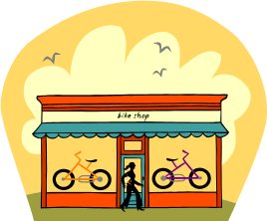
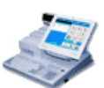
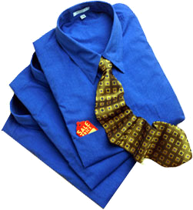
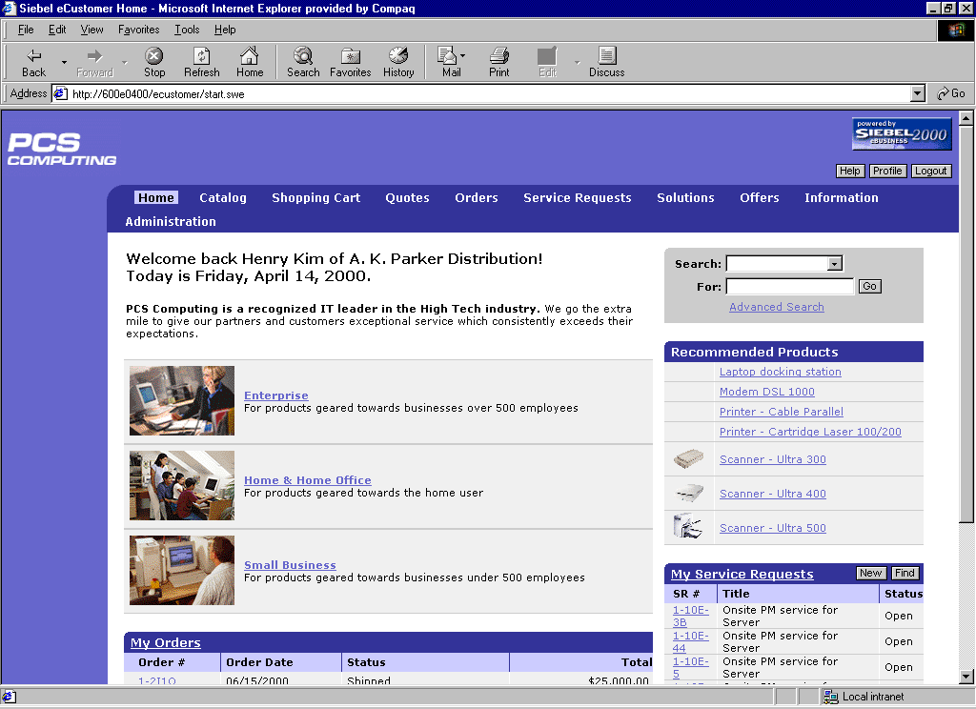




IBM’s RDW 1st Generation: Functional Areas Addressed
Customer Management Group
Purchase Profiles
Customer Profiles
Product Purchasing Recency, Frequency & Quantity
Campaign & Promotion Analysis
Cross Purchase Behavior Analysis
Target Product Analysis
Customer Movement Dynamic
Market Basket Analysis and Clienteling
Store Operations Group
Loss Prevention
Store Location Analysis
Store Optimization Staffing
Product & Services Group
Transactions
POS
Product Change
Customer Touch
Location
Core Business Reporting
Product Analysis
Vendor Performance
Service Delivery
Planning and Forecasting
Web
Multi-Channel
Group
Call Center
e-Commerce Analysis
Catalog Analysis
Call Centre Performance
Catalog
Corporate Finance
Merchandising Group
Pervasive
Capital Allocation
Partner Credit Risk
Finance Management
Income Analysis
Inventory Analysis
Assortment / Allocation Analysis
Promotion Analysis
Physical Merchandising
Space Management Analysis
Pricing Analysis
A end-to-end
cross-organizational
perspective

Slide 15
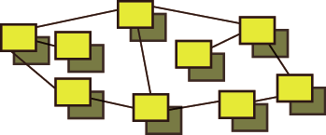


The IBM DB2 RDW Models → 3 models in 1
Retail Data Warehouse Model (RDWM)
Logical Entity-Relationship Model for the central data warehouse
Consolidate the data from throughout the enterprise into one comprehensive view
→
Retail Business Solution Templates (RBSTs)
Logical Measure/Dimension Models for multidimensional analysis
Organize the data into specific areas for advanced analysis… guided analysis
→
Retail Services Data Model (RSDM)
Classification (Meta data) model for defining business meaning across all models and databases
Define the business meaning and relationships of all the data captured in the RDWM and RBST model
→
M1 Tool
IBM’s solution is unique – other competitors have RDWM equivalent model only

Slide 16
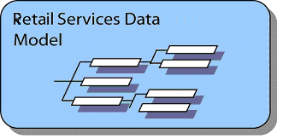
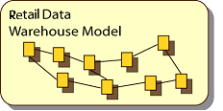
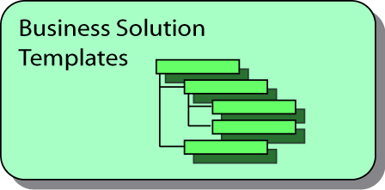
The RDW Architecture
RSDM provides overall corporate model with common language & terms
Data Warehouse design specific for Retail Organizations gives full enterprise DW blueprint
Data Mart Templates for Retail Organizations, enable fast accurate requirements gathering
Logical Design
EDW designed for Retail Organizations can be generated over a series of manageable phases
Mapping between BSTs and RDWM enable rapid scoping
Data Mart DB design can be generated from Templates
Business
Applications
Sources
Essbase
Enterprise Data Warehouse
ROLAP
Customers
POS
Summary
Staging
Area
System
Of
Record
Merchandizing
OLAP
Server *
Front
Office
Analysis
Products
Physical Design
Feedback
Relational
Store Ops
Classified
Sources
Accounting
Data Analysis
& Reporting
Other
Inventory
ETL/Messaging
Data Mart
Structures
Data Mining
HR
Predictive
Modeling
Other
Sources
Warehouse Management & Administration
Metadata Management & Metadata Repository
Mgt Reporting

Slide 17
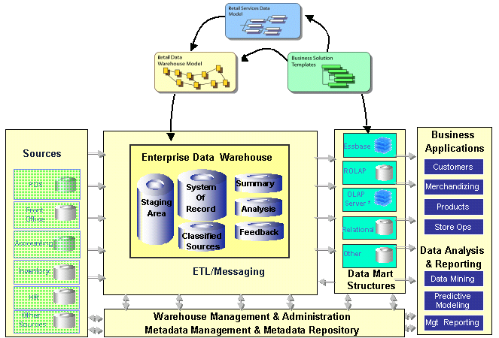
What is the RDWM?
The RDW Environment
Contains :
Flexible System of Record
Commonly-required Summaries
Sample Analysis Schemas
Feedback Area
Intended to be customized
Approx 80% of Customer’s Requirements for a Central Warehouse
Low-level flexible model
Generic
“One-step from Physical”
Enterprise-wide Logical Model
Entity-Relationship
Consists of over 71 Subject Areas, 671 Entities, 4067 Attributes
Fully defined and documented

Slide 18
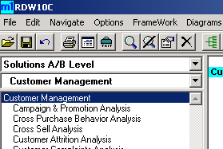
What are RBSTs? - Definitions
What are the Business Solution Templates?
  The Retail Business Solution templates are a grouping of measures and dimensions that satisfy a particular business requirement.
What are measures?
  Measures are facts that are used to quantify business performance indicators. These measures may be made up of other measures (known as sub-measures) in the context of the measure to which they contribute. An example of a Measure is 'Number Of Customers'
What are dimensions?
  Dimensions consist of criteria or segments by which the measures may be broken down. Dimensions consist of at least one level of Dimension Members. An example of a Dimension is 'Time Period'

Slide 19





What do the RBSTs Cover? - Overview
Campaign & Promotion Analysis
Cross Purchase Behavior Analysis
Cross Sell Analysis
Customer Attrition Analysis
Customer Complaints Analysis
Customer Credit Risk Profile
Customer Delinquency Analysis
Customer Interaction Analysis
Customer Lifetime Value Analysis
Customer Loyalty
Customer Movement Dynamics
Customer Profile Analysis
Customer Profitability
Involved Party Exposure
Lead Analysis
Market Analysis
Market Basket Analysis
Product Purchasing RFQ
Analysis
Purchase Profile Analysis
Target Product Analysis
Customer Management
Merchandising
Management
Assortment and Allocation Analysis
Inventory Analysis
Physical Merchandising / Space Management Analysis
Pricing Analysis
Promotion Analysis
Products &
Services
Management
Business Performance Analysis
Planning and Forecasting Analysis
Product Analysis
Product profitability
Service Delivery Analysis
Transaction Profitability Analysis
Vendor Performance Analysis
Store Operations
Management
Activity Based Costing Analysis
Location Exposure
Location profitability
Loss Prevention Analysis
Non Performing Loan Analysis
Organization Unit Profitability
Performance Measurement
Staffing Analysis
Store Location Analysis
Store Optimization Analysis
Suspicious Activity Analysis
Corporate Finance
Management
Capital Allocation Analysis
Credit Risk Analysis
Financial Management Accounting
Income Analysis

Slide 20
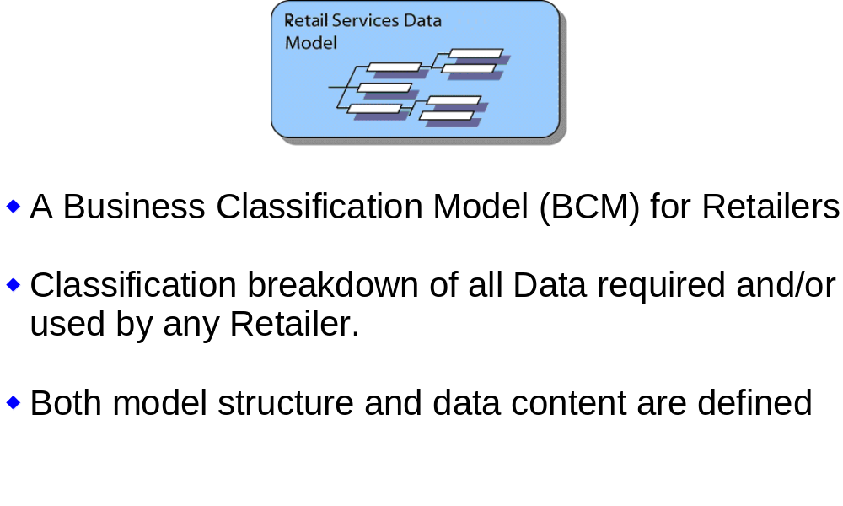
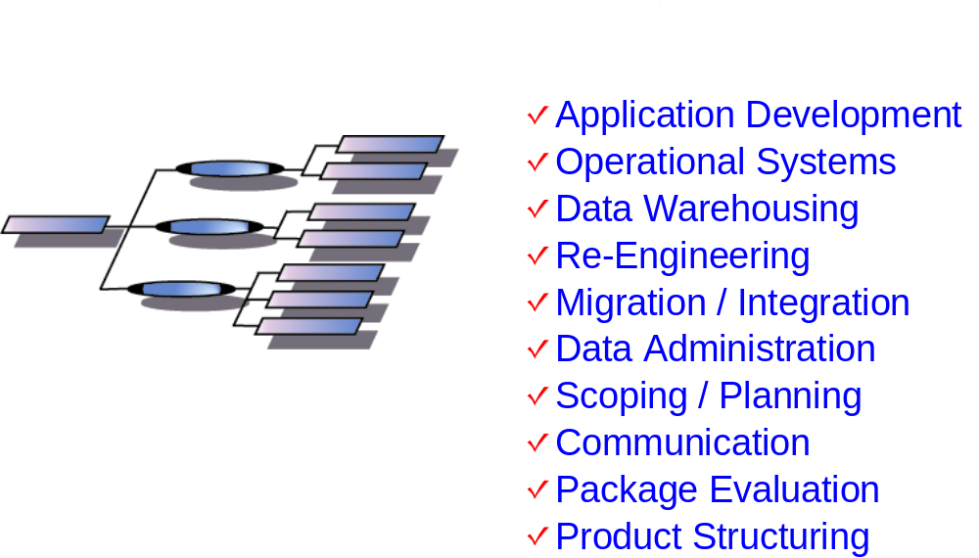
What is the RSDM?

Slide 21
Why is IBM’s RDW Solution Important?
Retailer requirements:
  A system that allows integration of information related to: CRM, multi-channel order mgmt., inventory analysis, product sales analysis, trends, category management, promotional (markdown) analysis, product returns, dead inventory, increased product turns, reduced out-of-stocks, maximize promotional effectiveness, RFID, and provide cashier metrics.
  A well-organized, fast, and easy to access repository of analytics and metrics to support BPM and provide for “activity based monitoring” for real-time (on-demand) action to address business conditions in role-based portal (LOB) workplaces: Merchant, Marketing, Store Operations.
Value to Retailers:
Essential to retail BPM: Business Performance Management
  Sense and Respond
  Triggers and Alerts responding to business conditions
Useful to Merchandisers for category mgmt., buying criteria, vendor analysis/performance, (markdown allowance)
Valued by Marketing for CRM RFM and real-time promotions and offers.
Real world use in Store Operations for real-time inventory alerts, labor scheduling, etc.
Provides retailers with (not only) access to timely information; but provides for real-time alerts and triggers to business conditions

Slide 22
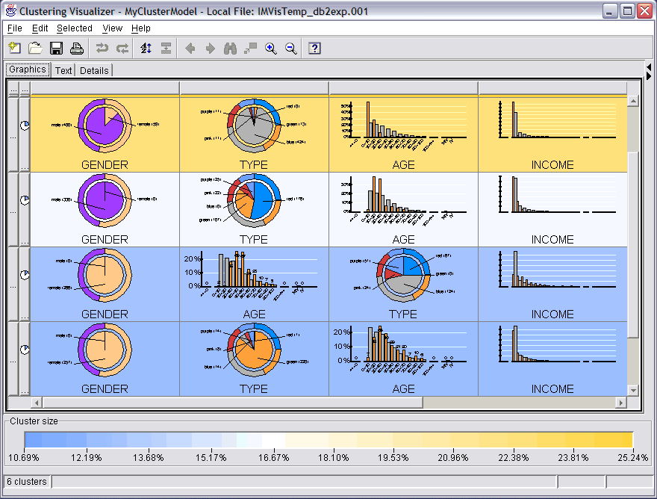
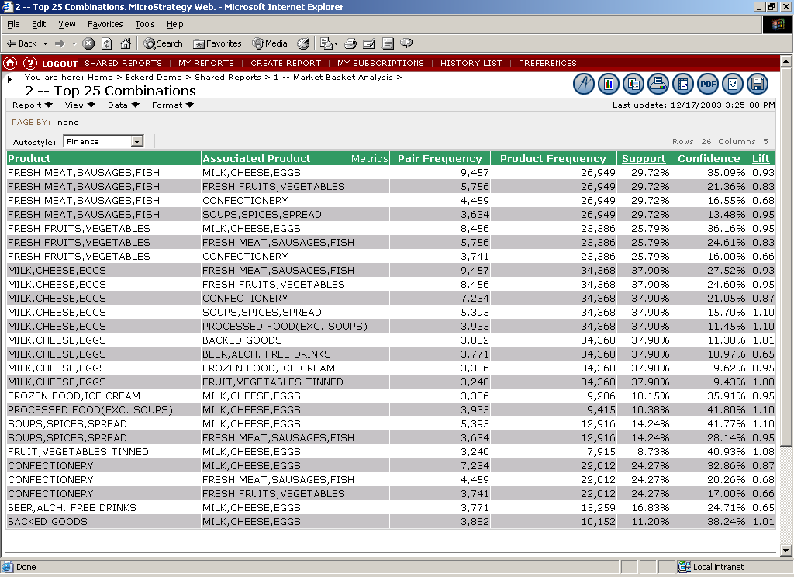
Embedded Advanced Analytics
Solution Differentiator
DB2 has a unique capability called Easy Mining that enables solutions based on data mining implemented in a business analyst’s workplace. Reporting tool vendors have developed interfaces to allow the solutions to integrate with existing reporting capabilities.
Embedded Business Solutions:
  Customer Segmentation
  Store Profiling
  Market Basket Analysis
  Promotion Targeting
Why Should You Care?
The business value of the solutions IBM is embedding in DB2 is well known. Retailers get insights into how their products sell together and how their stores and customers perform. These advanced analytical solutions were once reserved for retailers with sophisticated statistical staffs but can now be enjoyed by all retailers.
Customers
Summary
Table
T Logs
Segmentation, Promotions
Transaction
File
Data Sources
Market Basket Analysis

Slide 23

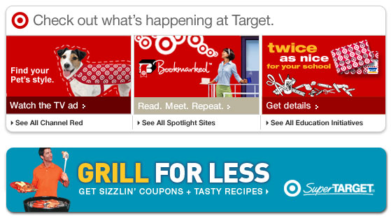
Case Study Mass Merchant
Challenge:
  To create support across the company for an enterprise data warehouse solution in an environment that is highly silo’d
  To develop an enterprise view of financial profitability across all business areas, products and departments (Consumer Credit, Merchandising and Store Operations)
Solution:
  IBM’s Retail Business Intelligence Solution with the REDW Data Model
  Services to support customization of the model to stress financial reporting issues
  DB2 Data Warehouse Edition with Business Objects
Benefits:
  Now able to see the complete profitability picture
$46B+ Mass Merchant Retailer
1337 Stores in 47 States
Notes:
Target

Slide 24


Case Study Specialty Apparel
Challenge:
  Integrate and operate new Disney Store acquisition
  Develop enterprise view of store and product information in short time frame (6 months or less)
  Deliver transaction level information to end users which can be leveraged by the Finance, Marketing and other business functions within the organization
  Leverage, not re-do, processing and technology that is already being done by the finance and marketing teams
Solution:
Retail Business Intelligence Solution with Retail Enterprise Data Model
DB2 DWE
Alphablox
Benefits:
Short time frames can be met and analytics leveraged
Marketing and Finance able to work on same page
$1.2b specialty retailer focused on children 0-10
Completed Disney Store acquisition in 2005
Notes:
Target

Slide 25
Summary
Retailers are heading into the next generation of advanced analytics with a global perspective
More and more they are incorporating close to real time decision capabilities
ROI is mature so that adding more BI capabilities inside the enterprise is common
Analyzing the store in real time is important
Open systems are driving standards based approaches
User communities continue to grow
  Delivery of data to executive decision makers is common
  Delivery to the store and store management
A common foundation for supporting all of these activities is derived through an enterprise model

Slide 26
Sample Scenario

Slide 27


Using an example “Back to School” promotion for children’s clothing
RDW typical usage scenario
Business Scenario
Planning and execution of a children’s clothing promotion,
across Merchandise, Marketing & Store Management
functions
Flow of this Scenario
Technology components:
  Cognos as the front-end analysis tool, over an Intranet
  DB2 as the Data Warehouse RDBMS and OLAP service
  RDW as the Retail Enterprise Data Warehouse Model, including classification of data meanings (metadata) and pre-defined analytic templates (BST’s)
1
Identification of a new merchandising opportunity for a key customer segment
2
Identification of a relevant offer based on purchasing behaviour
3
Planning for execution of the promotion at store

Slide 28
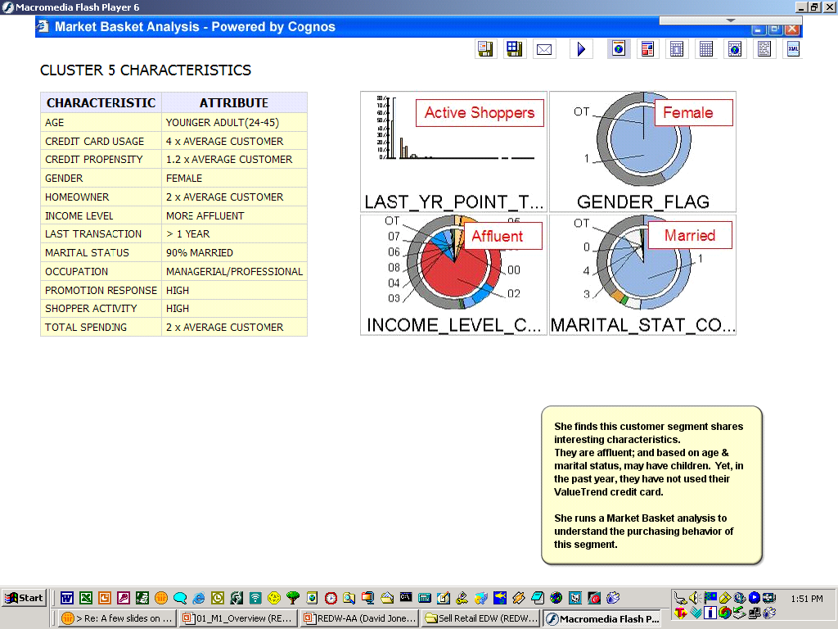
RDW typical usage scenario
1
2
3
“Back to School” promotion : Childrens Clothing
Merchandiser identifies an opportunity with a customer segment, identified from store-card usage
Source: RDW Customer Management
Purchase Profiles
Customer Profiles
Product Purchasing Recency, Frequency & Quantity
Campaign & Promotion Analysis
Cross Purchase Behavior Analysis
Target Product Analysis
Customer Movement Dynamic
Market Basket Analysis and Clienteling

Slide 29
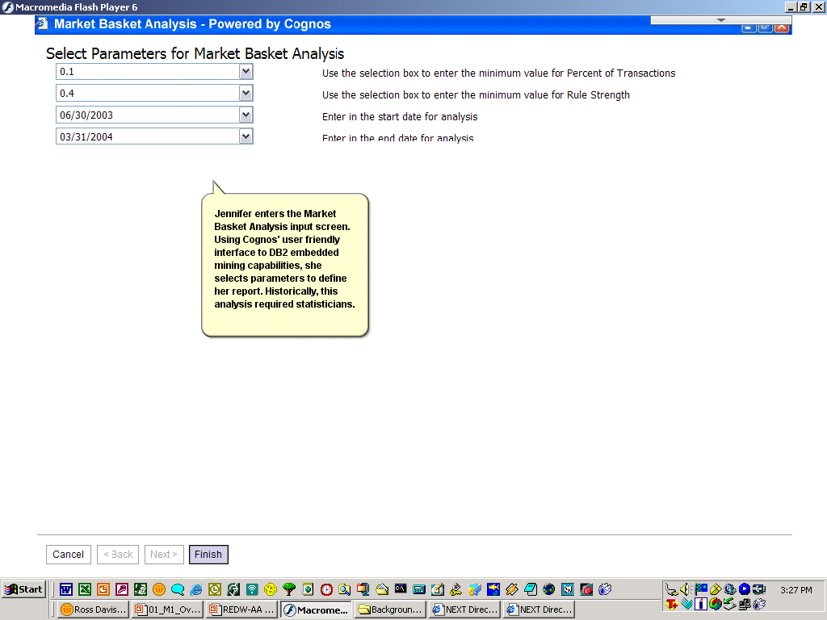
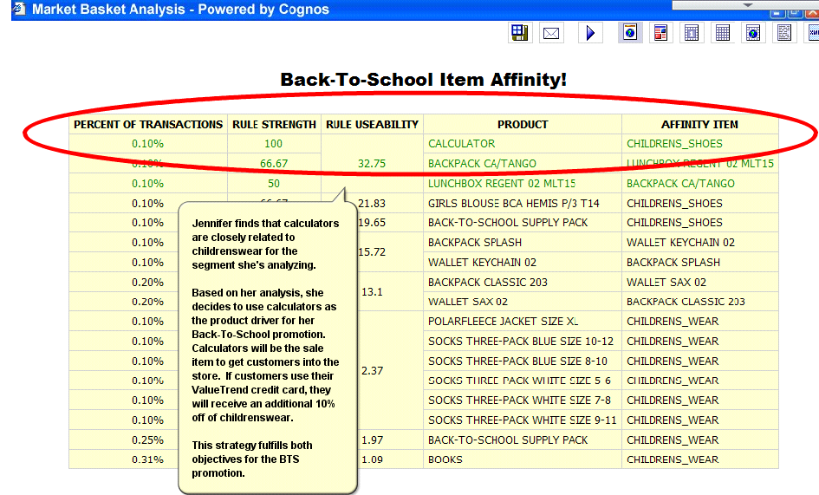
RDW typical usage scenario
1
2
3
“Back to School” promotion : Childrens Clothing
Merchandiser identifies an offer based on ‘affinity’ with another prod dept (calculators)
Source:
RDW Customer
Management
Purchase Profiles
Customer Profiles
Product Purchasing RFQ
Campaign & Promotion Analysis
Cross Purchase Behavior Analysis
Target Product Analysis
Customer Movement Dynamic
Market Basket Analysis
and Clienteling

Slide 30
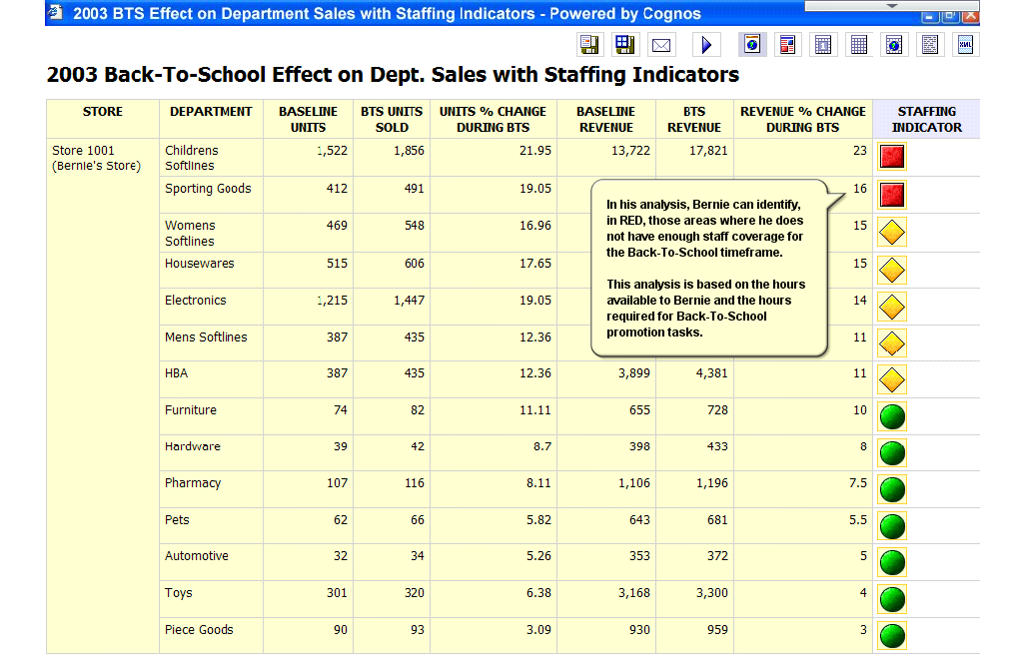
RDW typical usage scenario
1
2
3
“Back to School” promotion : Childrens Clothing
Once aware of the impending promotion, the Store Manager looks at previous year revenue and staffing levels – preparing the ‘balancing act’
Source: RDW Store Operations
Loss Prevention
Store Location Analysis
Store Optimization Staffing

Slide 31
Advanced Analytics

Slide 32

Solutions through Analytics
Query
  Question and Answer
  “Drill Down”
  Standard Reports
Online Analytical Processing (OLAP)
  Multi-dimensional queries and reports
  Complex Q&A
Data Mining (Advanced Analytics)
  Discover previously unknown trends and patterns
  “We don’t know what we don’t know”
IBM has a new approach to make data mining easy
Notes:
We can loosely group the methods of gathering and analyzing information from databases into three areas, query, OLAP and mining.
Query is exactly what its name implies, the ability to ask questions and get answers. This is sometimes called “drill down”. An analyst might want to know what sales were for a particular store for a given item. The answer to that question might generate additional questions such as how that store sold a similar item, or how the item performed at a similar store. The analyst postulates a theorem, and the tool enables the analyst to check its validity. For instance, the analyst might think that a certain purse would appeal to high income shoppers and may ask questions of the data to verify that belief. Query is usually done through a query tool, such as QMF, or for more analytically oriented analysts may be done through a spreadsheet.
OLAP is a special form of query where multidimensional questions may be asked and multidimensional responses obtained. It’s more complex, but it yields rich reports which may be broken out in a number of ways. An analyst could get a report showing sales of all purse skus, across all stores, totaled by region, store type, market segment … Again, however, we are in a question and answer mode with the analyst testing predispostions about the outcome. The data is still just answering questions.
Mining is about using statistical algorithms on data to find trends and patterns that may not have been previously known. The analyst asks very general questions without necessarily having an idea of the result. Which of my stores behave similarly? Which of my customers are similar in their buying behavior? Which of my products sell together, how strong is the relationship?

Slide 33




Partners Support Business Intelligence Solutions
Mining invoked by end user tool
  Familiar, easy to use tool
  DB2 mining is just a menu button!
  “Easy Data Mining” solutions
    Customer Segmentation
    Store Segmentation
    Promotion Targeting
    Market Basket Analysis
Business analyst does the mining
  Expert data miner not required
Ease of use emphasis
DB2 Alphablox
DTG
Notes:
The PTM is an IBM patented methodology to enable DB2 to perform data mining without a data miner. We will go into some detail on the PTM.

Slide 34
Store Segmentation
Opportunities
  Markdowns are too high
    Stores have to put items on sale to move them
    We aren’t stocking what our customers want
  Which stores should run selected promotions?
  Which items should be promoted in which stores?
  What factors determine store profitability?
Solution
  Store segmentation provided by partner reporting tool using DB2
    Reporting tool is for control and display
    DB2 does the mining in the background
Transaction (TLOG POS) summaries by store
Customer or postal code demographics (nice to have)
Transaction log data summed by:
  SKU
  Category
  Department
  Day, week, month etc.
Normalized data
  Eliminate size as a factor
  Isolate behavior
  Subset of products selected to address opportunity
Experienced thought leaders
  Data
  Business
Notes:
Data mining is the key to doing any kind of consumer segmentation. Using actual data and purchase behaviors is infinitely preferable to extensive surveys and executive anecdotes about the types of consumers. Only by segmenting can an enterprise organize their spending priorities, their messages and offers, and in general all resources associated with the customer.
Segmentation lets you identify both the high value spenders now and those that can easily become high spenders. Keep in mind that not everyone who spends high amounts of money are profitable. Some milkt the warranty, call centers, or promotions until they produce little or no profit. So finding the right kinds of consumers is not simply looking at who spent the most money.
Within each target segment, you can organize your messaging and offers. That is, your brochures, your contract terms, your advertising, and the direct mail. The brochures should have pictures that look similar to the audience –for example a hispanic family versus a retired couple illustration. And the Ts & Cs of each offer must be built to match the financial position of the consumer. Each major segment should be communicated throughout the company and be used to drive business process behaviors. It must not be bottled up in the marketing department. The shipping, order entry, call center, sales, and other departments need to know how to treat and manage each segment of client.
Ultimately, segmentation allows you to buy external data to locate new prospects. By comparing their attributes to known profitable customer segments, you can determine the type of “treatment” most likely to attract that consumer to do business with you. Whether its direct mail, sales leads, of SPAM, you can now prospect to clients in a more personalized way.
Similarly, segmentation lets you identify consumer groups who are most likely to switch to competitors. Therefore, you can prioritize some amount of funding to communicate with those customers to remind them of the value of your relationship. Since you cannot spend money to “remind” all clients, segmentation lets you prioritize the ones you want to keep vis-à-vis the ones most likely to leave.

Slide 35






Requirements for Customer Segmentation
  Summaries of transactions about selected opportunity for each potential target customer by:
    Day , Week, Month, Year, Life time
    Store
    Web
    Response to promotions
    Years as customer
    Life time spend
    …
  Demographics
    Append by postal code
    Derive from spending history
    Legal environment on purchased data changing
  Experienced thought leader

Slide 36
Promotion Targeting
Opportunities
  “Our response rate on customer promotions is too low.”
  “We don’t have data miners to target promotions, so we just do it using our experience.”
Solution
  Promotion targeting provided by partner reporting tool using DB2.
    Reporting tool is for control and display
    DB2 does the mining in the background
  New statistical algorithm makes promotion targeting available to business analysts
. “ Promotion targeting uses the most complex form of data mining and so only retailers with a skilled data mining staff or who are willing to outsource could use it.”
IBM’s easy mining makes promotion targeting available as a function performed by a business analyst.
Notes:
Promotion targeting: Using past purchasing as a guide we can identify a group of customers who are good targets for a selected product. The PTM will identify our other customers who are most similar to them.
Promotion targeting is based on predictive analysis.
Traditional predictive mining involves a well known series of steps to identify trends from historic behavior and project them into the future.
We extract historic data relative to the problem with a know outcome.
We transform, or modify, the data to make it amenable to mining. For instance we may group individuals into age groups rather than deal with individual ages.
We divide the data into train and test sets. The answers are embedded in the data. The algorithm builds a model by analyzing the training set and evaluating results based on the embedded answers. We test how good the model is by applying it to the test set (not used to build the model).
When the model is good enough we apply it to data for which we don’t know the answer (the future).
Classification is about forming classes that we are interested in and assigning customers or stores to them. Examples would be 1) top targets 2) good targets 3) marginal targets 4) unlikely targets.
Prediction yields a specific probability of the result occurring. John Doe is 87.4% likely to respond to this offer.

Slide 37
Vendor Collaboration / Promotion Targeting
Provides the ability to efficiently create, present and drive customized offers, across multiple channels, to individual shopper, based on purchase history
Vendor Collaboration
Promotion Targeting
Attract more promotions from all CPG suppliers.
  Offer better campaign feedback.
  Provide information about identified prospects beyond the targeting criteria.
  Provide feedback on success segmented by customer attributes.
Enrich every promotion.
  Provide requested targets, but also offer other, similar groups with high probability of success.
Offer Promotions to customers most likely to respond
  Similar to those who already buy the product
  Total view of customer used to determine
All good targets identified, even those not previously understood to be targets.
Promotion not offered to those who purchase anyway
Notes:
Vendor collaboration is about maximizing vendor dollars and promoting all potential customers. Promotion targeting entails only promoting those customers not currently heavily buying the promoted product. So with promotion targeting we don’t send the promotion to the extracted good customers, but only to the similar ones.

Slide 38
Sample Customer BST’s and Reports
Purchase Profiles BST
Category Sales Report by Demographics
Loyalty Points Issued by Store
Sales Value / Quantity by Products vs Customers
Product Group Average Sales Quantity per Transaction
Product Group Average Sales Value per Transaction
Product Penetration (to Geography, geo- demographic mix)
Customer Profiles BST
Customers Attribute report
Customers Status by Attribute report
Cumulative Percentage Sales by Decile (10% segment) report
Sum of Purchase Made by Decile report
Customer Base Dynamics report
Loyal Purchasers Subsequent Behavior report
Customer Details report
Product Purchasing Recency, Frequency & Quantity BST 6 Month Customer Age Group Segment RFQ report
Repurchase Interval
Repurchase Propensity
Distribution of Customers by Number of Units
Distribution of Transactions by Number of Units
Campaign & Promotion Analysis BST
Sales Performance by Campaign Response
Sales Performance by Campaign Cell
Target Period Sales Proportion Index Sub-Class
Target Period Sales Value Index by Age Range
Target Period Sales Value Index by Product
Cross Purchase Behavior Analysis BST
Count of Cross Purchasers
Cross Purchasers Subsequent Behavior
Target Product Analysis BST
Sales Quantity Proportion
Average Transaction Quantity
Average Transaction Value
Sales Value Proportion
Customer Movement Dynamic
Customer Acquisition & Defection report
Segment Migration Comparison report
Market Basket Analysis (Clienteling)
Cross Merchandising (what’s in a basket)
Demographic profile to market basket
Statistical reports
Association report – product

Slide 39
Sample Product and Services BST’s and Reports
Business Performance Analysis BST
New Item Introduction
Vendor Performance – sales reports by vendor
Discontinue analysis
Sales Quantity by Products
Vendor Compliance - billing, delivery,
Vendor Fulfillment
Vendor Rebate
Cannibalization impact
New Item Launch coverage
Sales Quantity Proportion by Products
Sales Value by Products
Sales Value Proportion by Products
Sales Value Proportion by Sub-Department
Target Product Transactions: Average Transaction Quantity
Target Product Transactions: Average Transaction Value
Target Product Transactions: Sales Quantity Proportion
Target Product Transactions: Sales Value Proportion
Vendor In Stock Position
Product Analysis BST
Product Performance by Store, Geography report
Product Category Performance report
Detail Product Category Breakdown report
Target Product to Customer report
Product Category Breakdown report
Product Equalization report

Slide 40
Sample Merchandising BST’s and Reports
Inventory Analysis BST
On Order V On Hand
Days of supply
Lag Time Report
Out of Stock .. by Product
Total cost of goods on hand by location
Damages / Stressed (garments) / Aged Products
Safety Stock Report
Slow moving inventory report
Transfer Report and Management
Assortment / Allocation Analysis BST
Traited v Value
Base Profit Contribution
Product Sales by Store Format
Category Performance by Store
Product Affinity
Product to Customer Profiles
Promotion Analysis BST
Promotion Sales Performance report
Overall Profit Contribution report
Promotion Effect by Media report
Promotion Effect by Media2 report
Promotional Response by Customer Segments
Promotional Response by Market Basket report
Promotional Impact on Store Traffic report
Promotional Category Impact report
Promotion Fade report
Physical Merchandising/Space Management Analysis BST
Same Layout Comparisons
Demographic Response to different Layouts
Revenue per sq Ft.
Category Profitability to Physical Presence
Days off of Supply of Product to Category
Optimization of Linear Footage to total store
Section elasticity / adjacency
Pricing Analysis BST
Set vs Actual Price Sold report
Price Competitive Exception report
Family Pricing (related products) report
Competitive Marketbasket report
Multi-Channel Price report
Markdown Trend report
Price Elasticity report

Slide 41
Sample Store Operations BST’s and Reports
Loss Prevention BST
Baseline exception reports
Cashier exceptions report - over and under, Voids
Inventory discrepancy
Employee Schedule compliance associated with loss
Receiver exception report
Staffing BST
Employee Schedule compliance
Cashier performance metrics
Cross training reports
Sales Person Productivity
Skills v Employees
Years of services report
Employee Details report
Store Location Analysis BST
Performance by Store Format report
Age of Stores report
Store Geo-Demographic Profiles report
Location Segmentation report
Performance by Store Type report
Store Detail report
Store Optimization
Projected Inventory V Sales Projections
Actual Inventory V Projected Inventory
On Order- Relationships V On –Hand Inventory

Slide 42
Sample Multi-Channel BST’s and Reports
eCommerce Analysis BST
Session cycle count analysis by period report
Session cycle comparison analysis by period report
Identified Shopper Segmentation analysis by segment by period
Identified Shopper Segmentation analysis by segment by period
Product Category analysis by period by trait report
Product Category Breakdown by time period report
Product Category Customer Segmentation by time period report
Clickstream patterns with sales results
Method used for payment to actual sales
Catalog Analysis BST
Cross catalog purchase profiles
Catalog mix to demographic response
Product placement to purchase propensity
Call Center Analysis BST
Operator closure rates
Script success rate to demographic
Cold call conversions to qualified
Failure causes and statistics

Slide 43
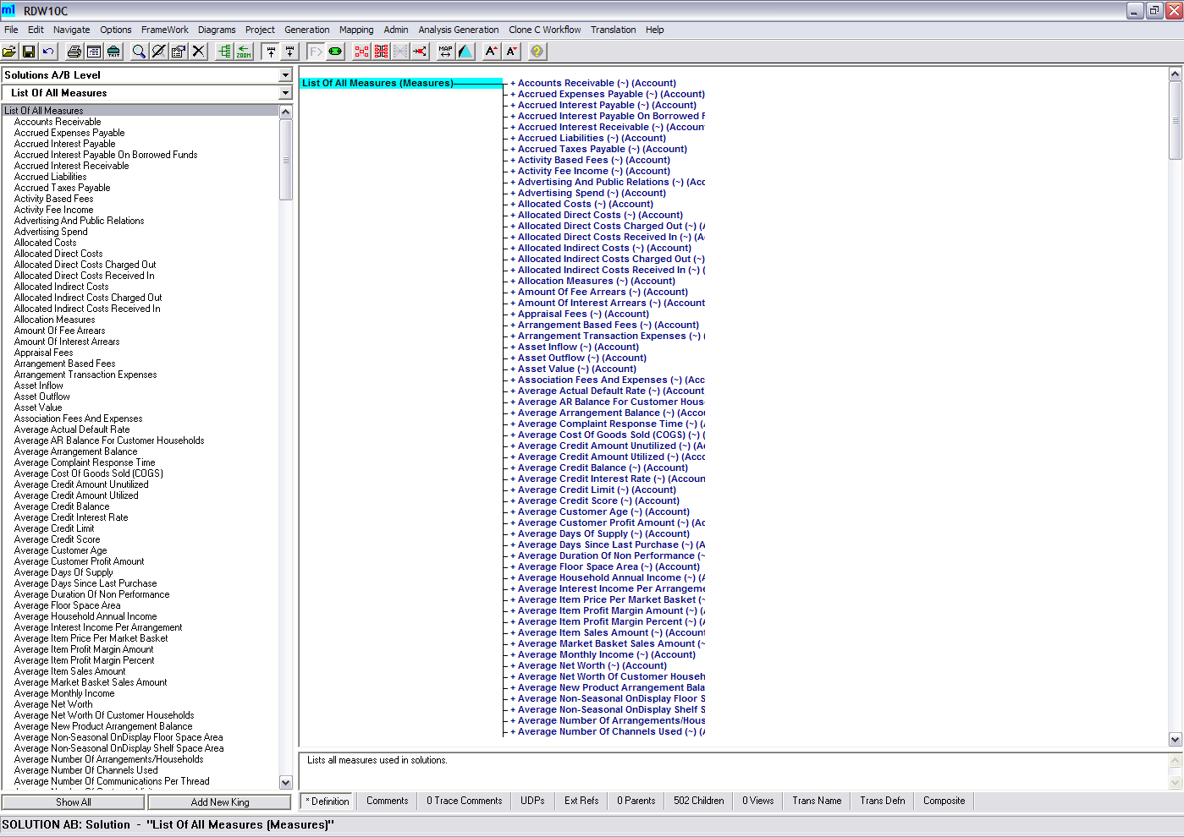
The RDW Environment
The M1 Tool provides a graphical interface to the RDW environment
The M1 gives a common place for the retailer user to see the environment in terms that are easily understood and defined the business user. It is the prime way of quickly customizing the RDW to your specific reporting and analytical needs.

Slide 44
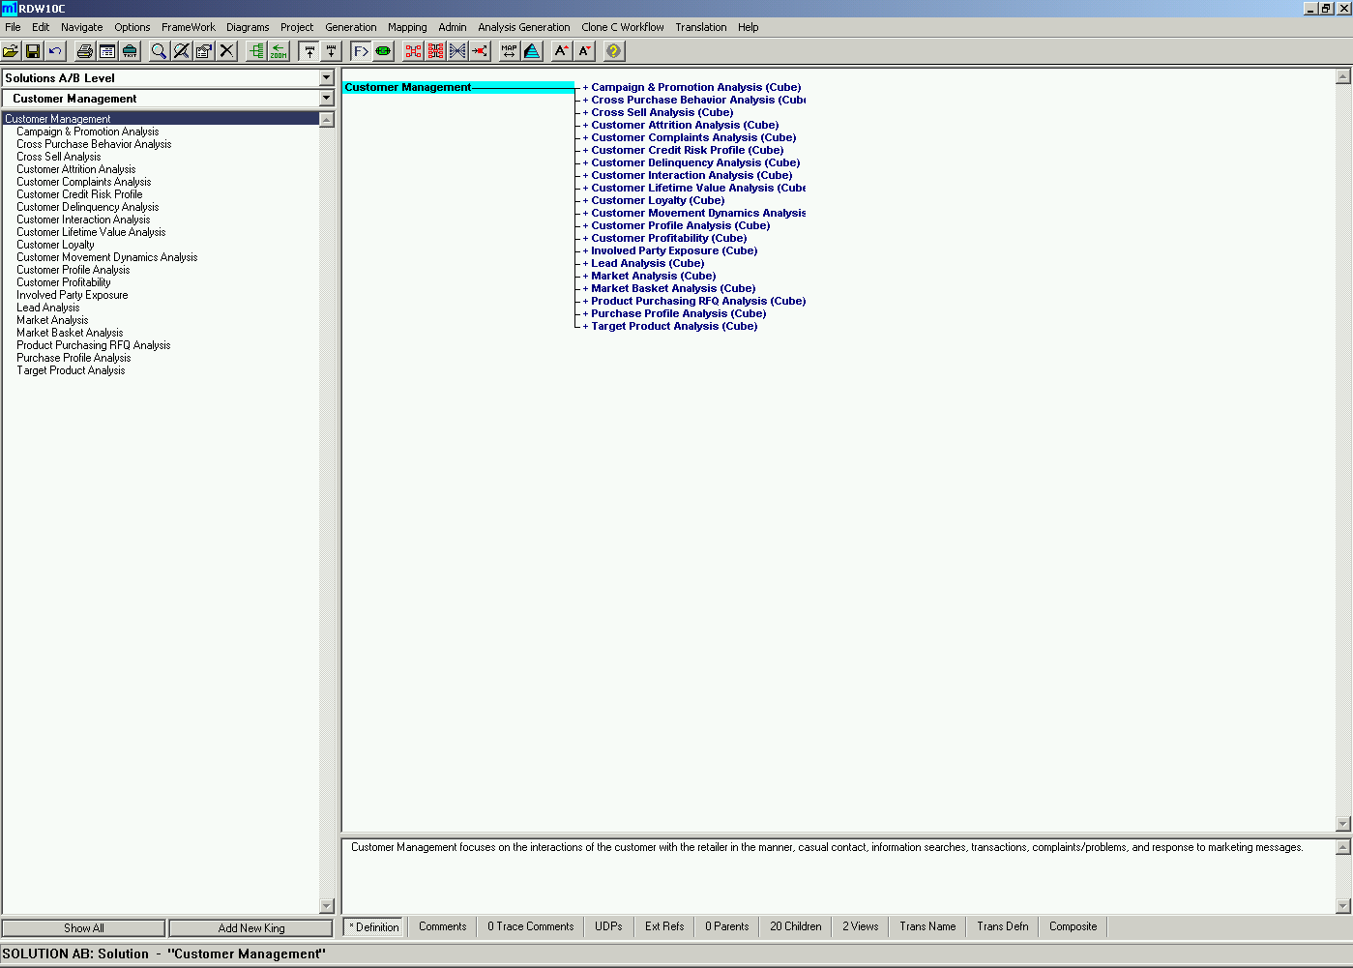
Customer Management

Slide 45
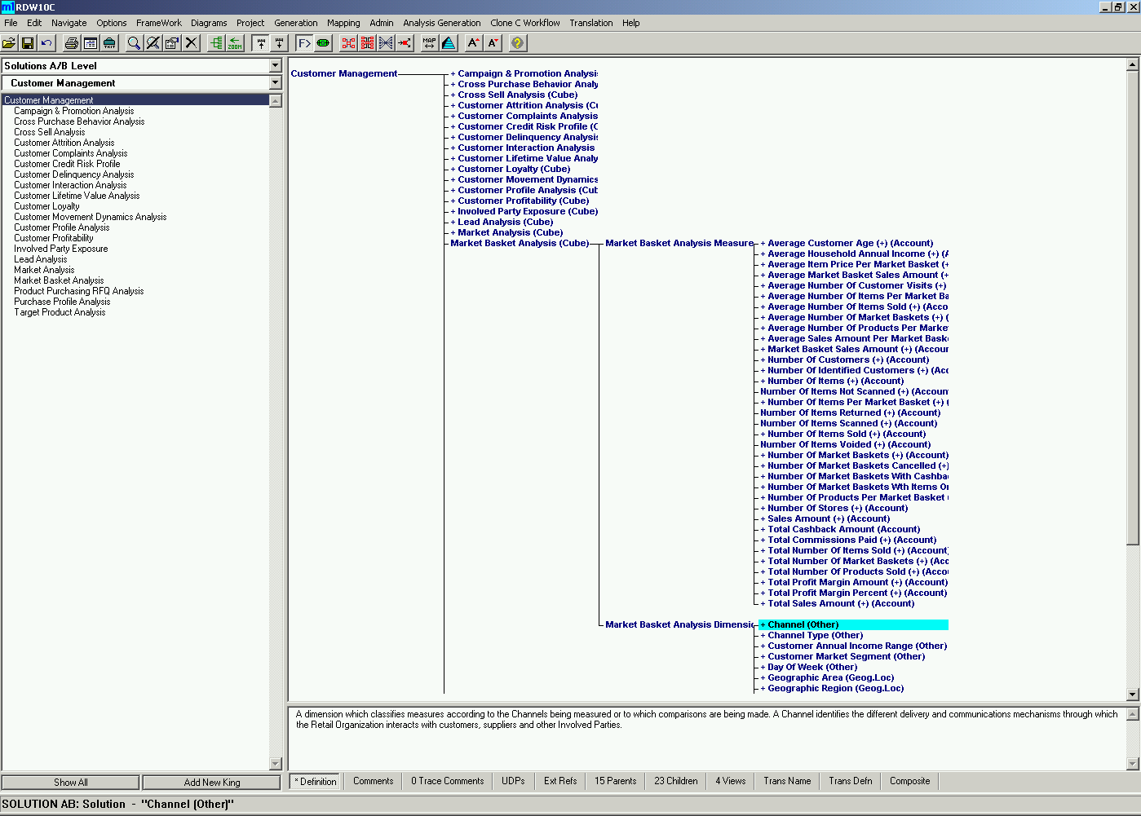
Customer Management
Marketbasket Analysis Measures and Dimensions

